Slide 1




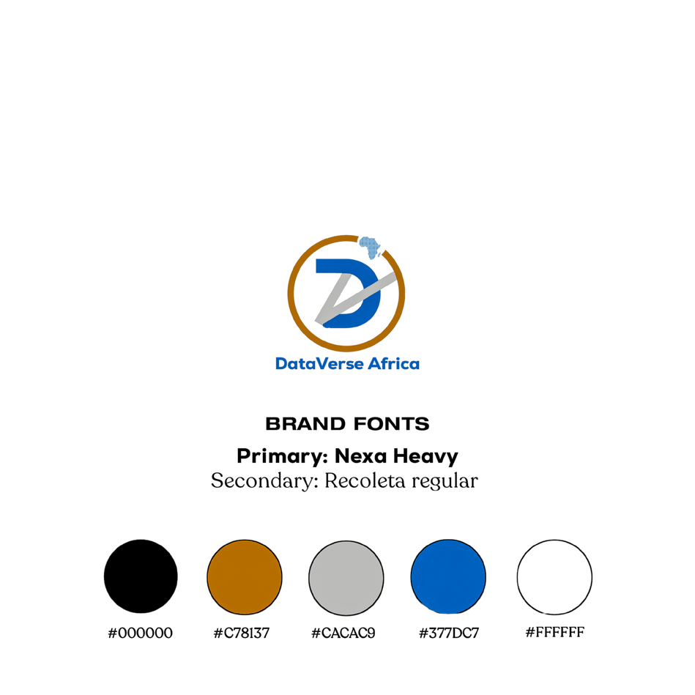

DataVerse
Africa
Trade And Custom Analytics
Internship Presentation
Group 25
Presented By:
OYINDAMOLA SARAH BABATUNDE
JOEL BABATUNDE

Slide 2


Problem Statement
The Trade and Customs industry faces challenges in efficiently managing import operations, taxation, and compliance while mitigating risks associated with high-risk imports. Inconsistent data entry, incomplete records, and outlier values can undermine data accuracy, impacting decision-making.
This report aims to analyze trade and customs data using key performance indicators (KPIs) to uncover insights, identify inefficiencies, and recommend data-driven solutions to enhance trade processes. The focus areas include:
Improving import volume and value tracking.
Enhancing tax collection and revenue management.
Streamlining logistics and shipment operations.
Strengthening compliance and risk management measures.

Slide 3

Project Objectives
Primary Objective
To optimize trade processes and customs operations by providing actionable insights into import volume, taxation, logistics, and compliance.
Secondary Objective
To enhance decision-making for customs authorities by identifying trends, risks, and opportunities, ultimately improving revenue collection, compliance, and efficiency.

Slide 4
Data Transformation
The dataset was cleaned using Python, Excel and Power Query techniques to ensure data consistency and accuracy. The process involved:
Correcting formatting issues in monetary values and dates.
Handling missing values and invalid entries.
Replacing erroneous dates and standardizing country names.
Converting data types for accurate analysis.
Applying Winsorization to manage outliers.

Slide 5
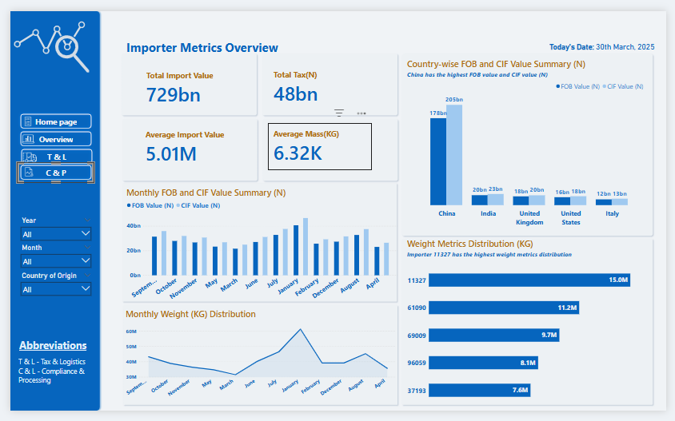
Data Insights

Slide 6
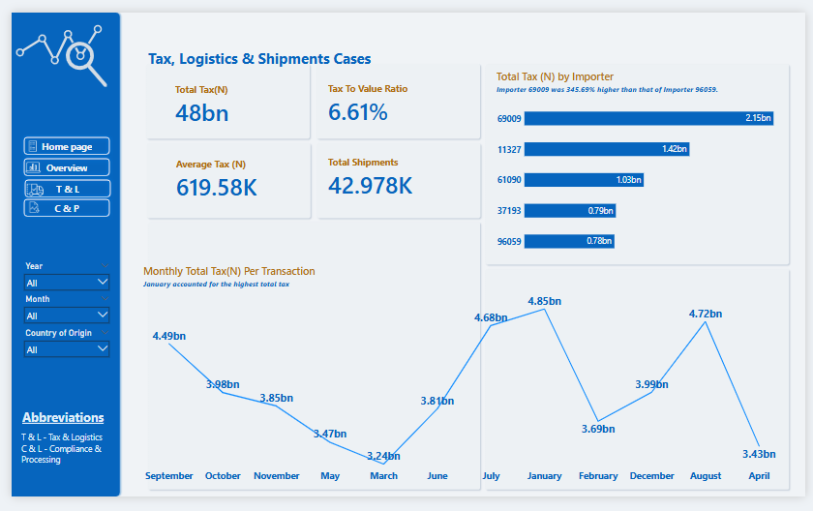
Data Insights

Slide 7
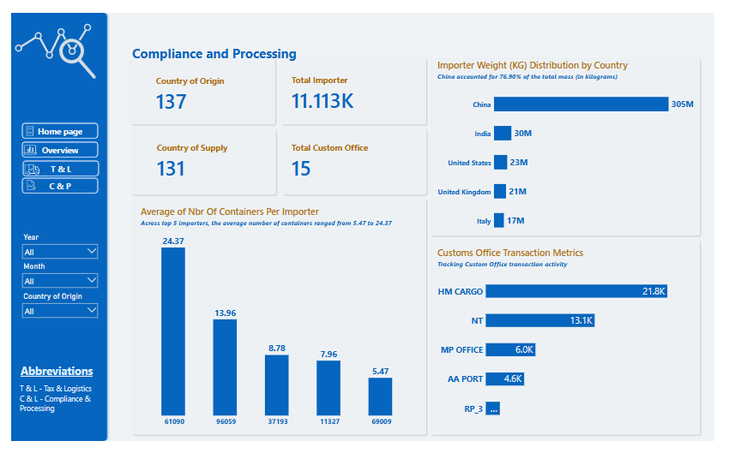
Data Insights

Slide 8
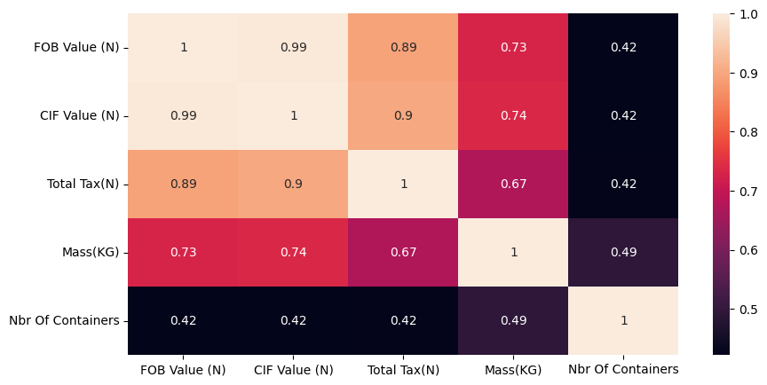
Data Insights
The darker the color, the weaker the relationship. The lighter the color, the stronger the relationship.
FOB Value and CIF Value are almost perfectly related (0.99). This makes sense because both represent the value of goods, just under different shipping terms.
Total Tax has a strong relationship with both FOB Value and CIF Value — which means as the value of goods goes up, the tax paid also increases.
Mass (KG) is also somewhat related to the value and tax — heavier shipments tend to cost more and attract more tax.
Number of Containers has a weaker relationship with the other variables — which suggests the number of containers doesn’t always increase just because the value or weight of goods increases.

Slide 9

Recommendation
Optimize Tax Collection
Implement stricter tax enforcement measures in high-volume customs offices (e.g., NT, MP Office).
Introduce automated tax calculations and monitoring tools to ensure accuracy and compliance.
Improve Supply Chain Efficiency
Streamline container usage by optimizing shipment consolidation, reducing costs, and improving logistics efficiency.
Implement predictive analytics to forecast shipment volumes and container requirements.
Mitigate Risks
Develop a risk-based compliance framework to closely monitor imports from high-risk countries (e.g., China and India).
Enhance import screening processes to identify and flag suspicious transactions.
Support Strategic Trade Relations
Diversify import sources by incentivizing trade with underutilized countries.
Establish long-term partnerships to reduce dependency on a few countries.
Enhance Compliance Measures
Automate tax payments, documentation handling, and customs processes in high-volume offices.
Introduce real-time compliance monitoring and alerts for delayed payments.

Slide 10


Implementation Plan
Phase 1 (0-6 Months) - Short-Term Initiatives
Automate tax calculations, documentation handling, and compliance measures.
Implement real-time monitoring tools for tax payments and customs processes.
Conduct risk assessments for high-risk countries and initiate compliance audits.
Phase 2 (6-12 Months) - Medium-Term Initiatives
Develop a centralized trade monitoring platform.
Roll out automated tax tools and compliance frameworks across all customs offices.
Phase 3 (12-18 Months) - Long-Term Initiatives
Establish strategic trade partnerships and incentives for trade diversification.
Integrate AI tools for predictive analytics and risk assessment.
Monitor and evaluate the impact of implemented measures and refine strategies.
Hands-on workshops
Case Studies
Simulations

Slide 11


Conclusion
The analysis successfully identified critical insights for optimizing trade and customs operations. Implementing the recommended measures can enhance decision-making, ensure compliance, and improve overall efficiency. Future analysis can focus on real-time monitoring and predictive analytics for enhanced operational efficiency.

Slide 12
DataVerse
Africa
Thank You
Internship Presentation
Presented By:
OYINDAMOLA SARAH BABATUNDE JOEL BABATUNDE

